Slide 1
Travel PLANNER ai agent
IBM HACKATHON PROJECT
Presented By:Soumya Roy
Student name :Soumya Roy
College Name & Department : Gurunanak Institute Of Technology and Computer Science And Engineering

Slide 2
OUTLINE
Problem Statement
Technology used
Wow factor
End users
Result
Conclusion
Git-hub Link
Future scope
IBM Certifications

Slide 3
Problem Statement
Travelers often find it overwhelming to plan trips due to the vast amount of information scattered across websites, apps, and travel sources. Choosing destinations, comparing accommodation, organizing transport, and managing bookings manually is time-consuming, confusing, and inefficient—especially when personal preferences, budgets, and real-time changes are involved.
Proposed Solution: An AI-powered Travel Planner Agent that leverages real-time data, Natural Language Processing (NLP), and intelligent recommendation systems to help users efficiently plan their trips. It understands user preferences and constraints to suggest destinations, build personalized itineraries, recommend transport and accommodation options, and manage bookings. Integrated with maps, weather updates, and local guides, the agent streamlines the entire travel planning process—ensuring a smooth, customized, and enjoyable journey from start to finish. It adapts to last-minute changes, provides proactive alerts, and continuously optimizes plans to enhance the overall travel experience.

Slide 4
Technology used
IBM Cloud Lite Services Cloud hosting & API integration for scalable deployment.
IBM Granite Model Pre-trained LLM for natural language understanding & personalization.
Natural Language Processing (NLP) Understands user intent and travel queries conversationally.
Retrieval-Augmented Generation (RAG) Combines search + generation to provide real-time, relevant travel info.
Real-Time Data Integration Live updates on flights, weather, transport, and local experiences.
Multi-Channel Deployment Supports web, mobile, and voice interfaces for seamless user interaction.
.

Slide 5
IBM cloud services used
IBM Cloud Watsonx AI Studio
IBM Cloud Watsonx AI runtime
IBM CLOUD FUNCTIONS
IBM CLOUD SERVICE
IBM CLOUD OBJECT STORAGE
IBM Cloud Agent Lab
IBM Granite foundation model(via watsonx.ai studio)
IBM AI TOOLS

Slide 6
Wow factors
This AI Travel Planner Agent will significantly reduce the time and complexity involved in organizing trips, enhance personalization, and empower users—whether solo travelers or groups—to explore more confidently and efficiently. It streamlines decision-making, adapts to real-time changes, and makes travel planning more accessible, enjoyable, and optimized.
Unique Features:
Semantic search across destinations, activities, and accommodations Uses intent-aware queries to help users discover ideal travel options based on interests, mood, or constraints.
AI-generated itineraries with dynamic adjustment Automatically drafts and updates daily plans based on user preferences, travel times, weather changes, and bookings.
Smart booking assistant with integrated price tracking Monitors and recommends optimal booking windows for flights, hotels, and tours while comparing platforms in real time.
Travel trend analysis and crowd forecast insights Helps users choose the best time to visit places by analyzing seasonality, crowd data, and regional events.
Group travel coordination and itinerary sharing Enables collaborative trip planning with friends, family, or colleagues—complete with voting, commenting, and real-time syncing.

Slide 7
End users
Individual Travelers Solo adventurers seeking personalized, stress-free planning.
Families and Groups Coordinated itineraries and collaborative planning for group vacations.
Travel Agencies and Tour Operators Smart assistance for itinerary creation, client recommendations, and bookings.
Corporate Travel Managers Streamlined planning for business trips, meetings, and events.
Digital Nomads and Remote Workers Support for long-term stays, coworking, and lifestyle-based travel.

Slide 8
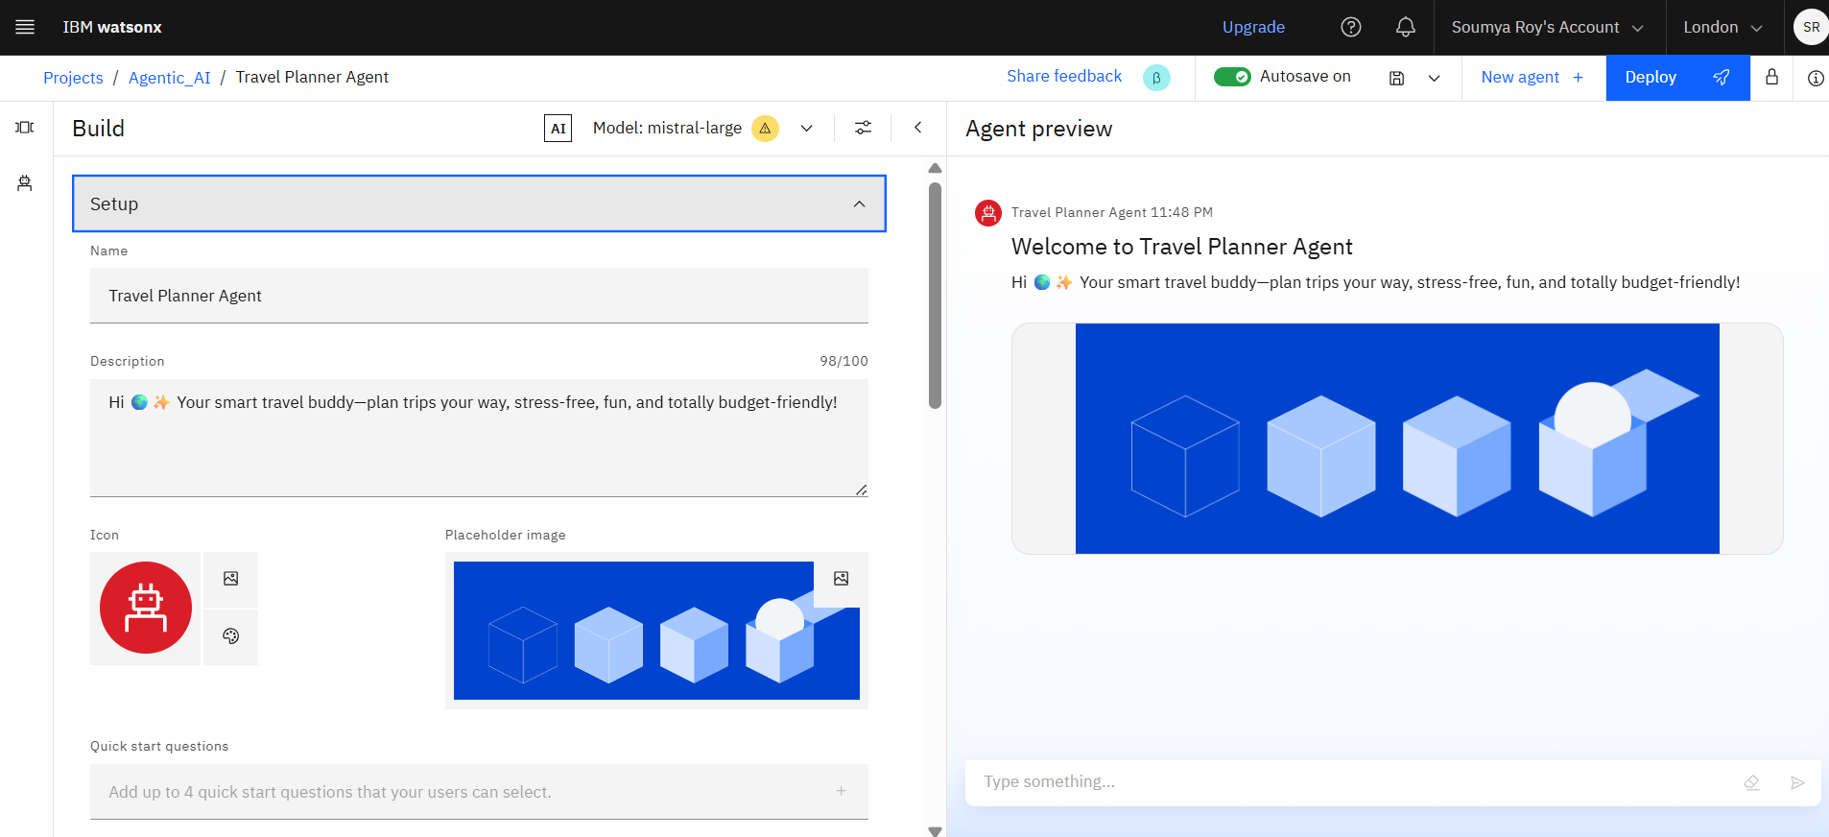
SETTING UP

Slide 9
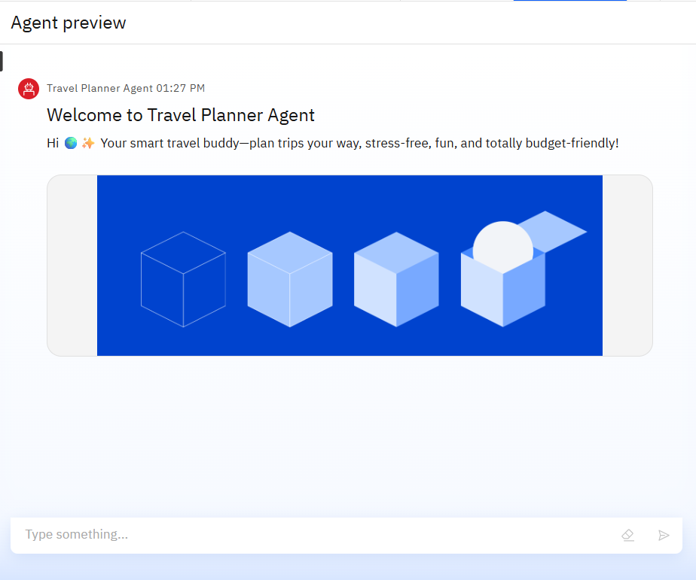
Results

Slide 10
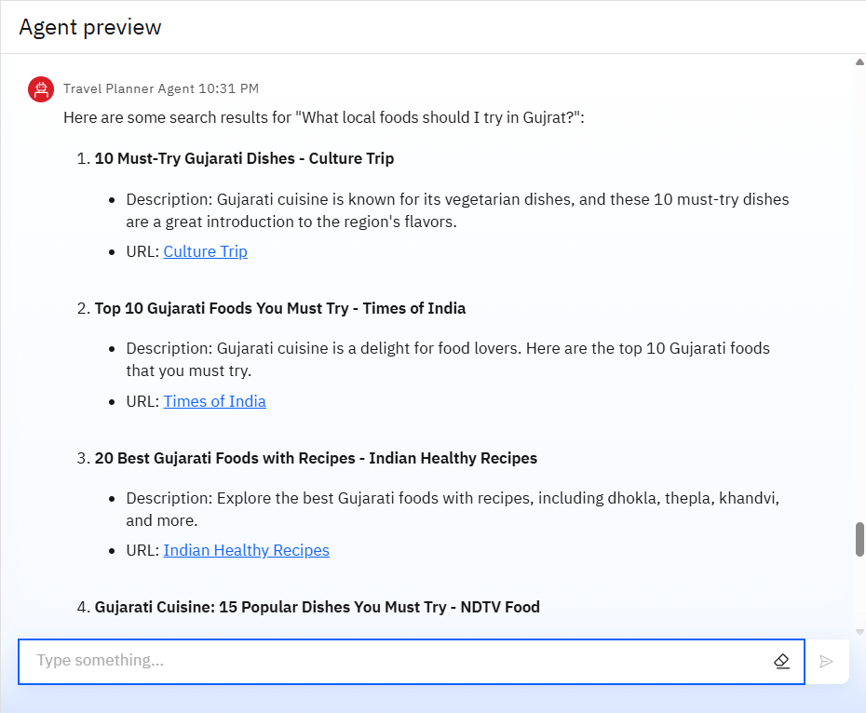
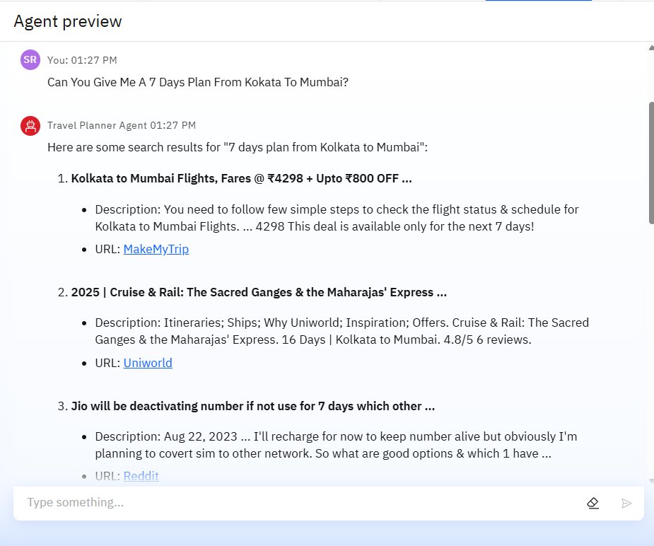
Results

Slide 11
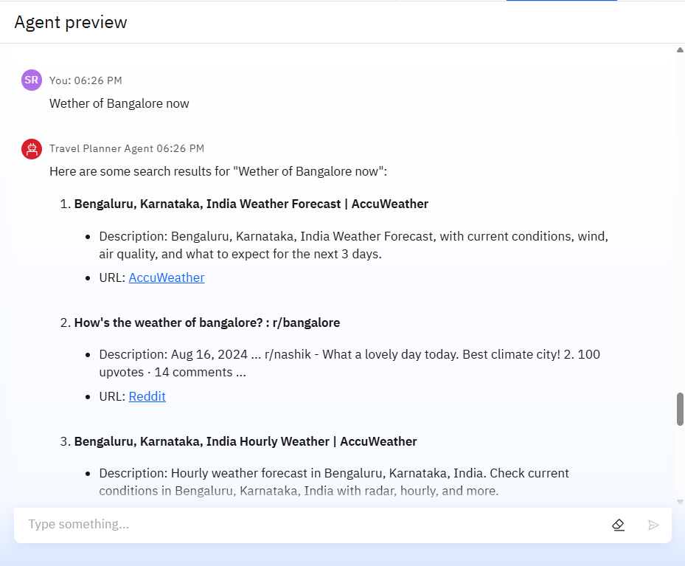
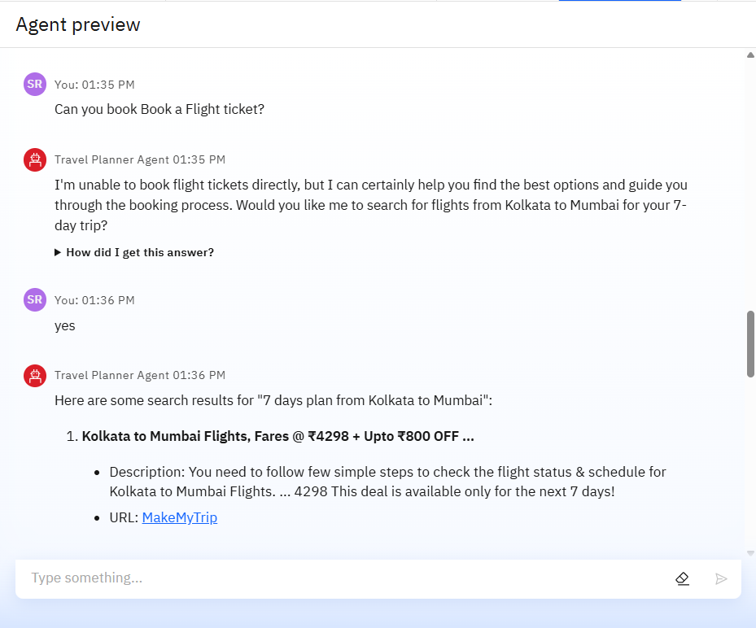
Results

Slide 12
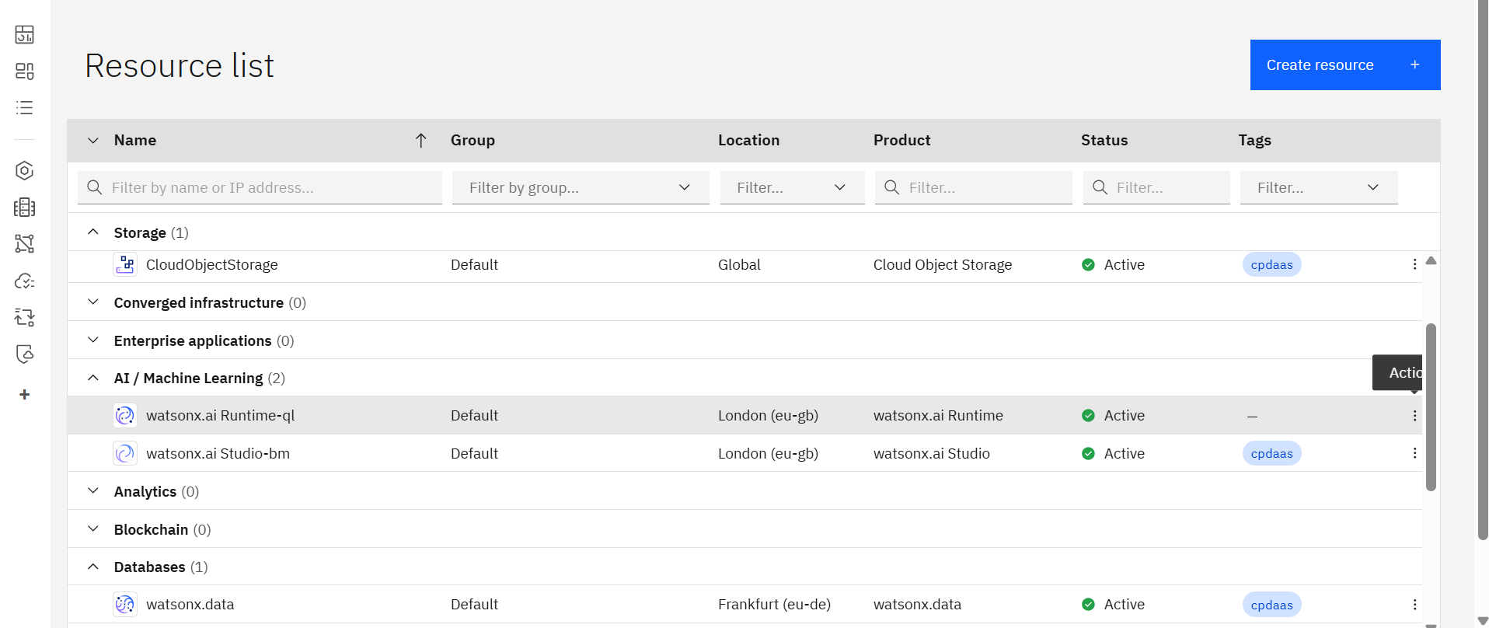
Resources list

Slide 13
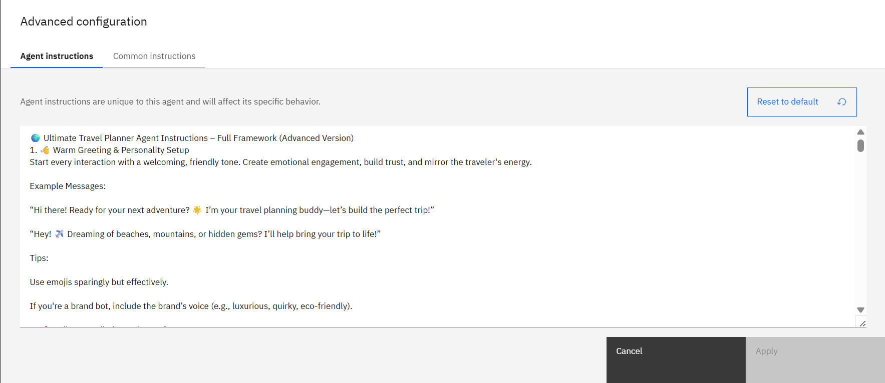
Agent INSTRUCTIONS

Slide 14
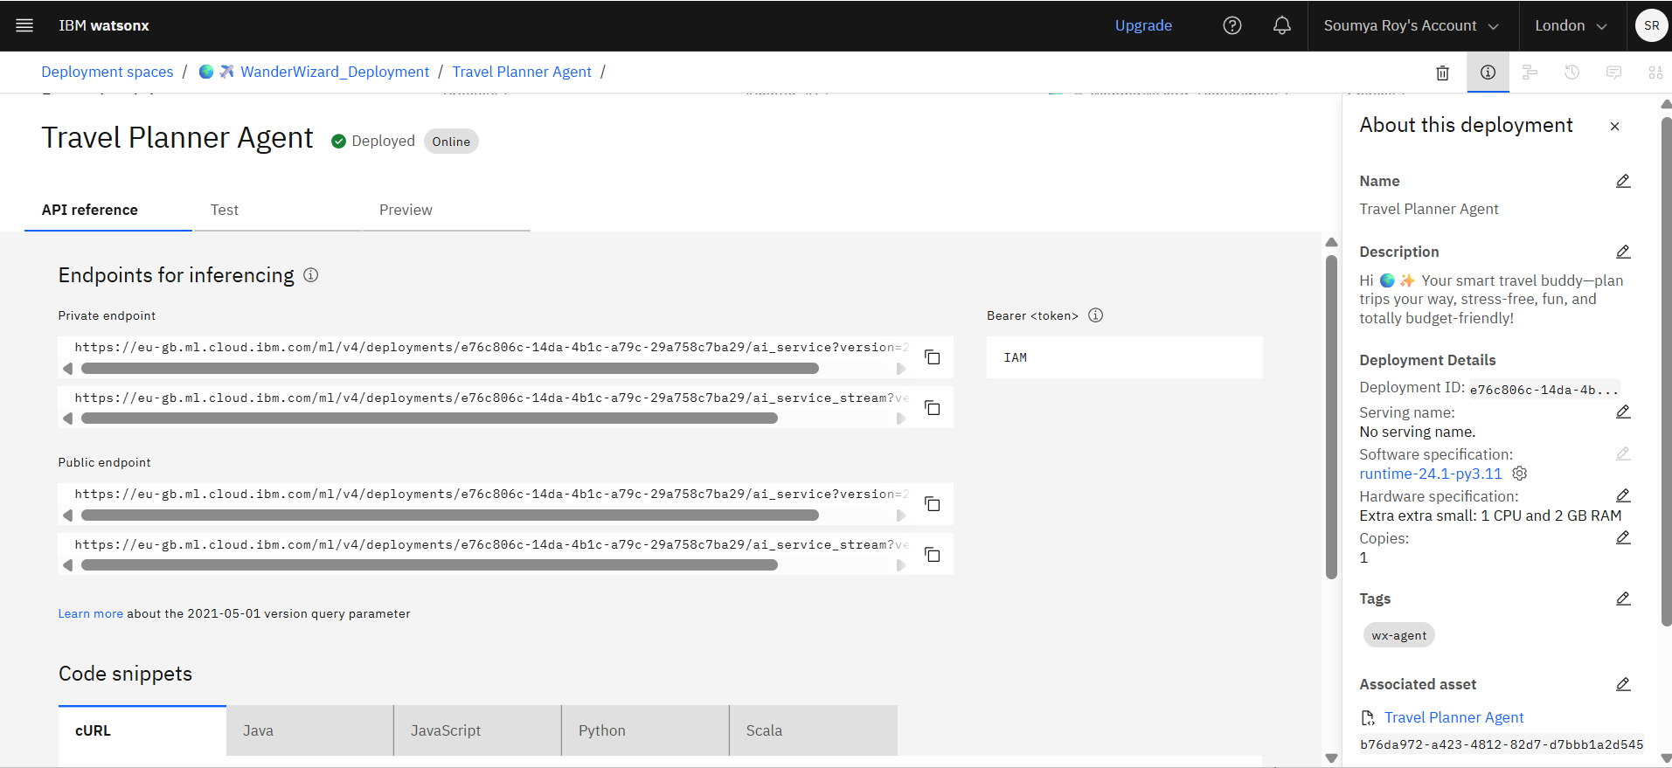
API REFERENCE AFTER DEPLOYMENT

Slide 15
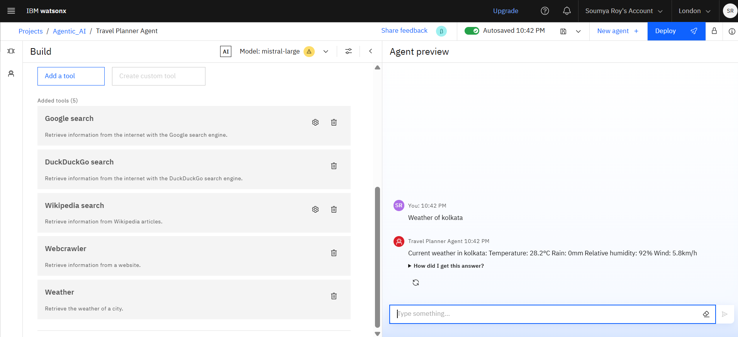
Tools used and testing

Slide 16
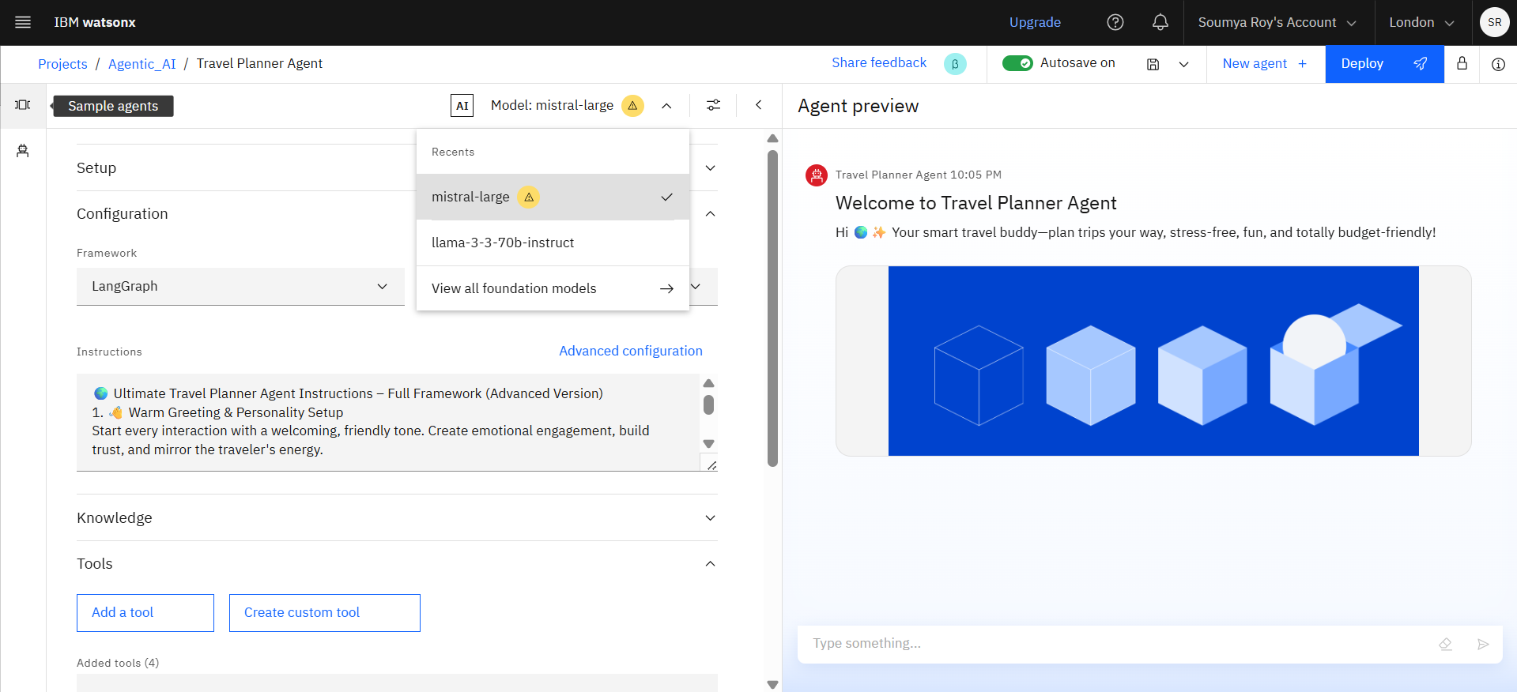
Model selection

Slide 17
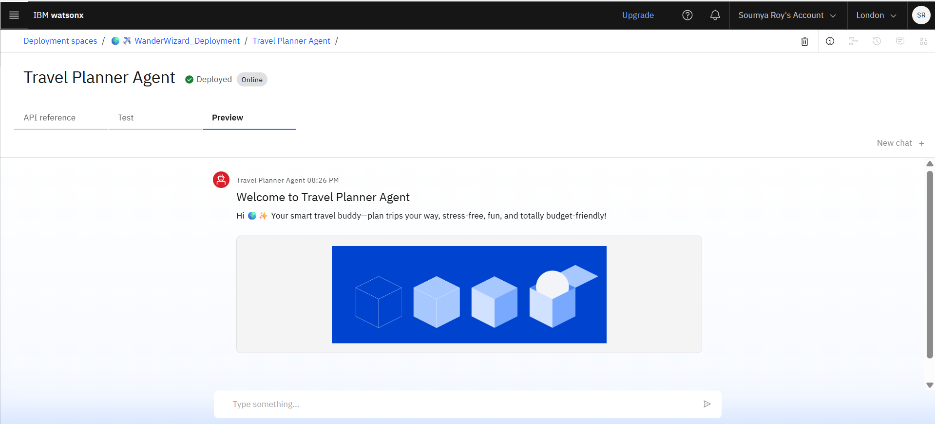
DEPLOYMENT AND PREVIEW

Slide 18
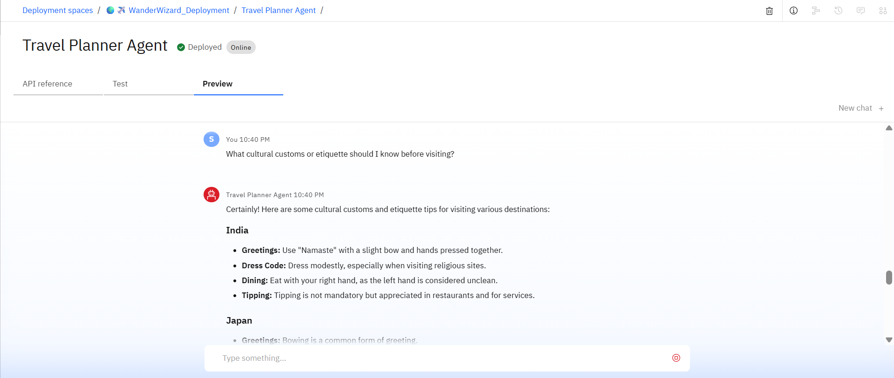
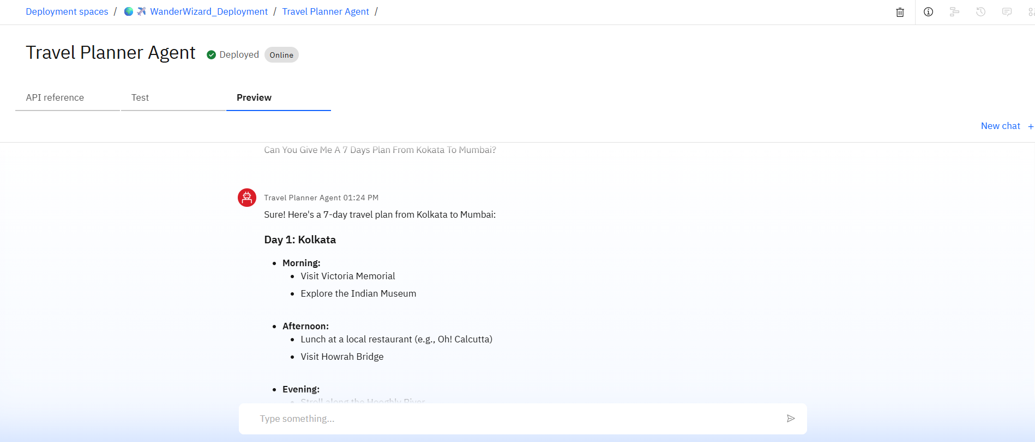
Deployment VIEW
Deployed AI Agent

Slide 19
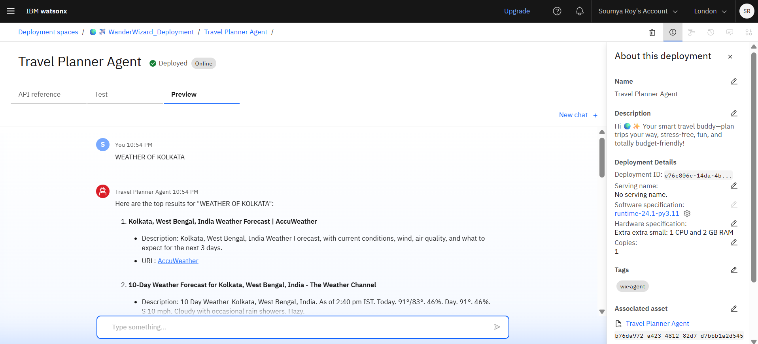
Another Deployment view of ai agent

Slide 20
Conclusion
Automates complex travel planning by handling tasks like itinerary creation, bookings, and route optimization.
Saves time and effort through real-time data integration, smart suggestions, and adaptive scheduling.
Personalizes experiences based on user preferences, travel history, budget, and style.
Improves decision-making with up-to-date information on destinations, weather, transport, and accommodation.
Enhances collaboration for group trips through shared planning tools and coordinated itineraries.
Boosts travel confidence and convenience, even for last-minute changes or unfamiliar locations.

Slide 21
GitHub Link
GITHUB LINK

Slide 22
Future scope
Multilingual Travel Support Understands and communicates in multiple languages to assist travelers across different regions, ensuring accessibility and cultural relevance worldwide.
Voice-Activated Travel Assistant Enables hands-free planning through voice commands—allowing users to search destinations, modify itineraries, or get updates while on the move.
Real-Time Group Trip Collaboration Allows families, friends, or teams to co-plan trips in real time, vote on activities, share preferences, and stay synchronized on a shared itinerary.
Interest-Based Trip Optimization & Hidden Gem Discovery Analyzes user preferences and past behavior to suggest unique experiences, local events, or off-the-beaten-path activities tailored to specific interests.
Integration with Booking & Travel Platforms Seamlessly connects with flight, hotel, activity, and transport booking platforms to streamline reservation processes and synchronize updates in one place.
AI-Assisted Itinerary Drafting & Route Optimization Automatically drafts a travel itinerary based on user inputs, optimizing for cost, time, location, weather, and personal pace—complete with smart route planning and local insights.

Slide 23
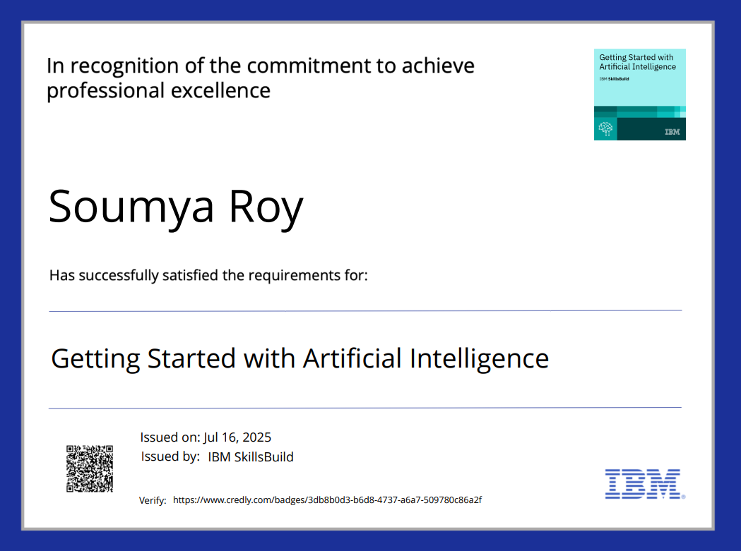
IBM Certifications
Screenshot/ credly certificate( getting started with AI)

Slide 24
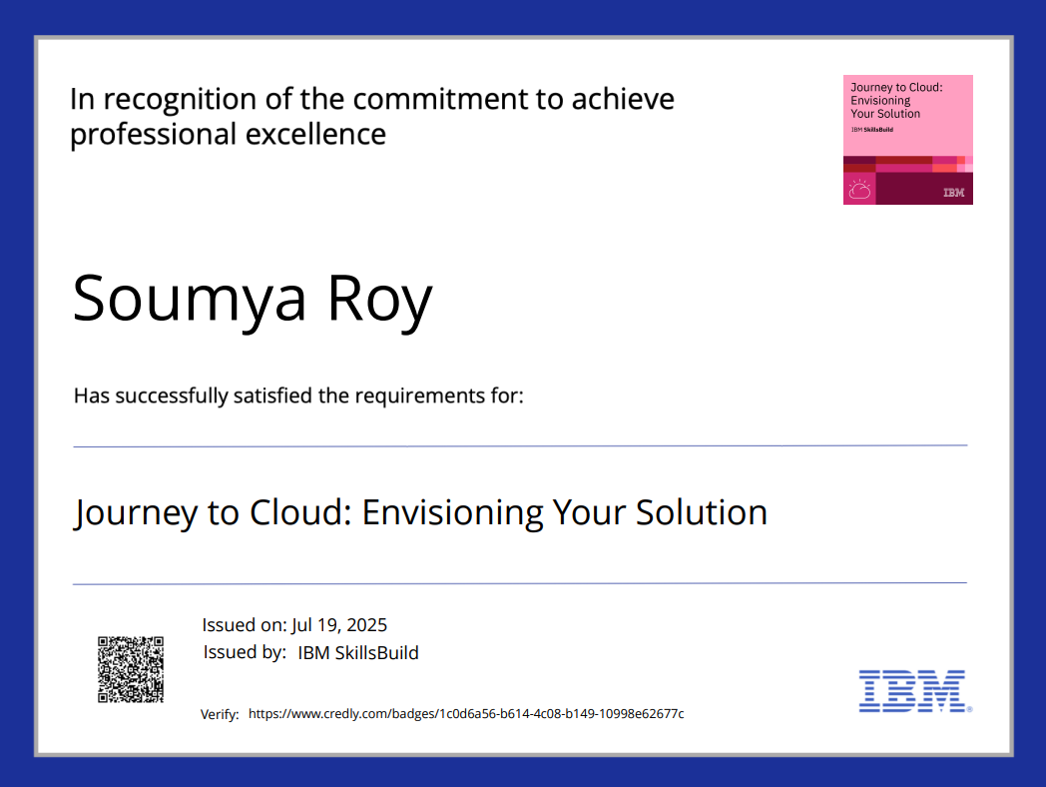
IBM CERTIFICATIONS IBM CERTIFICATION

Slide 25
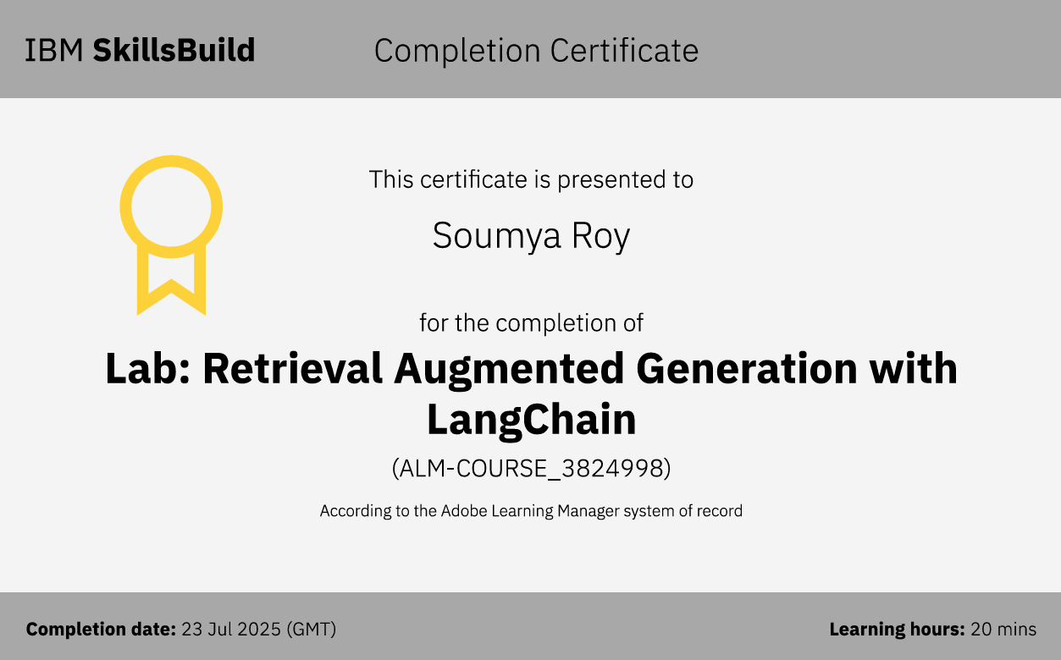
IBM CERTIFICATION

Slide 26
THANK YOU

